Slide 1

Targeting the Truth

Slide 2
Concept Framework
Gap
Method
Question
How do factors like location, rent, unemployment, distance to distribution centers, median income, and population impact Target's pricing strategies and cost of living?
The Bureau of Labor Statistics only has general nation or MSA data
‘Real Time’ grocery prices from Target and location-based controls
EDA to visually demonstrate division, urban, suburban, and rural differences. Along with a map to see distance to distribution centers from each location
Inference linear regression to explore the relationship between variables
Model
EDA

Slide 3
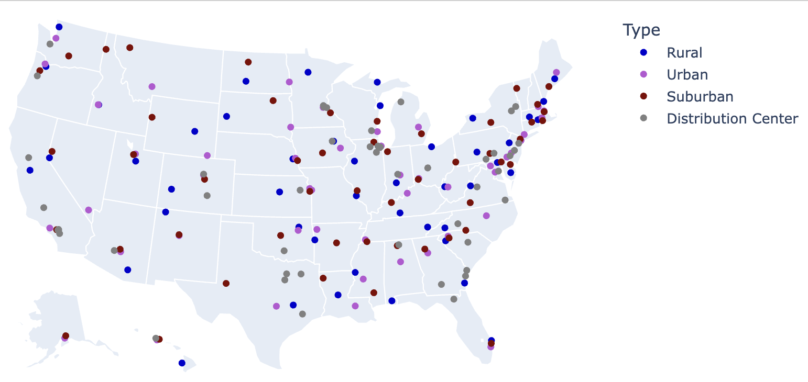
Map

Slide 4
Data Sources
Data Source | Features
Target | Bananas, milk, eggs, cotton swab, diapers, gum, shampoo, t-shirt, toilet paper, vegetable oil, and AirPods
Rent Data | Studio, one bedroom, two-bedroom, three-bedroom, four bedroom (combined to average)
Census | Area type, population, unemployment rate, division, and median income
Target Warehouse | Target warehouse locations (coordinates)
Economic Policy Institute | Living cost estimate
Thoughtfully curated grocery basket, selecting goods with perceived variety of price variance
Web scraping with Selenium WebDriver
Found consistent pricing with t-shirt, diapers, and AirPods
API for rentdata.org, epi.org and census.gov
Target distribution center locations obtained from a warehouse information website

Slide 5
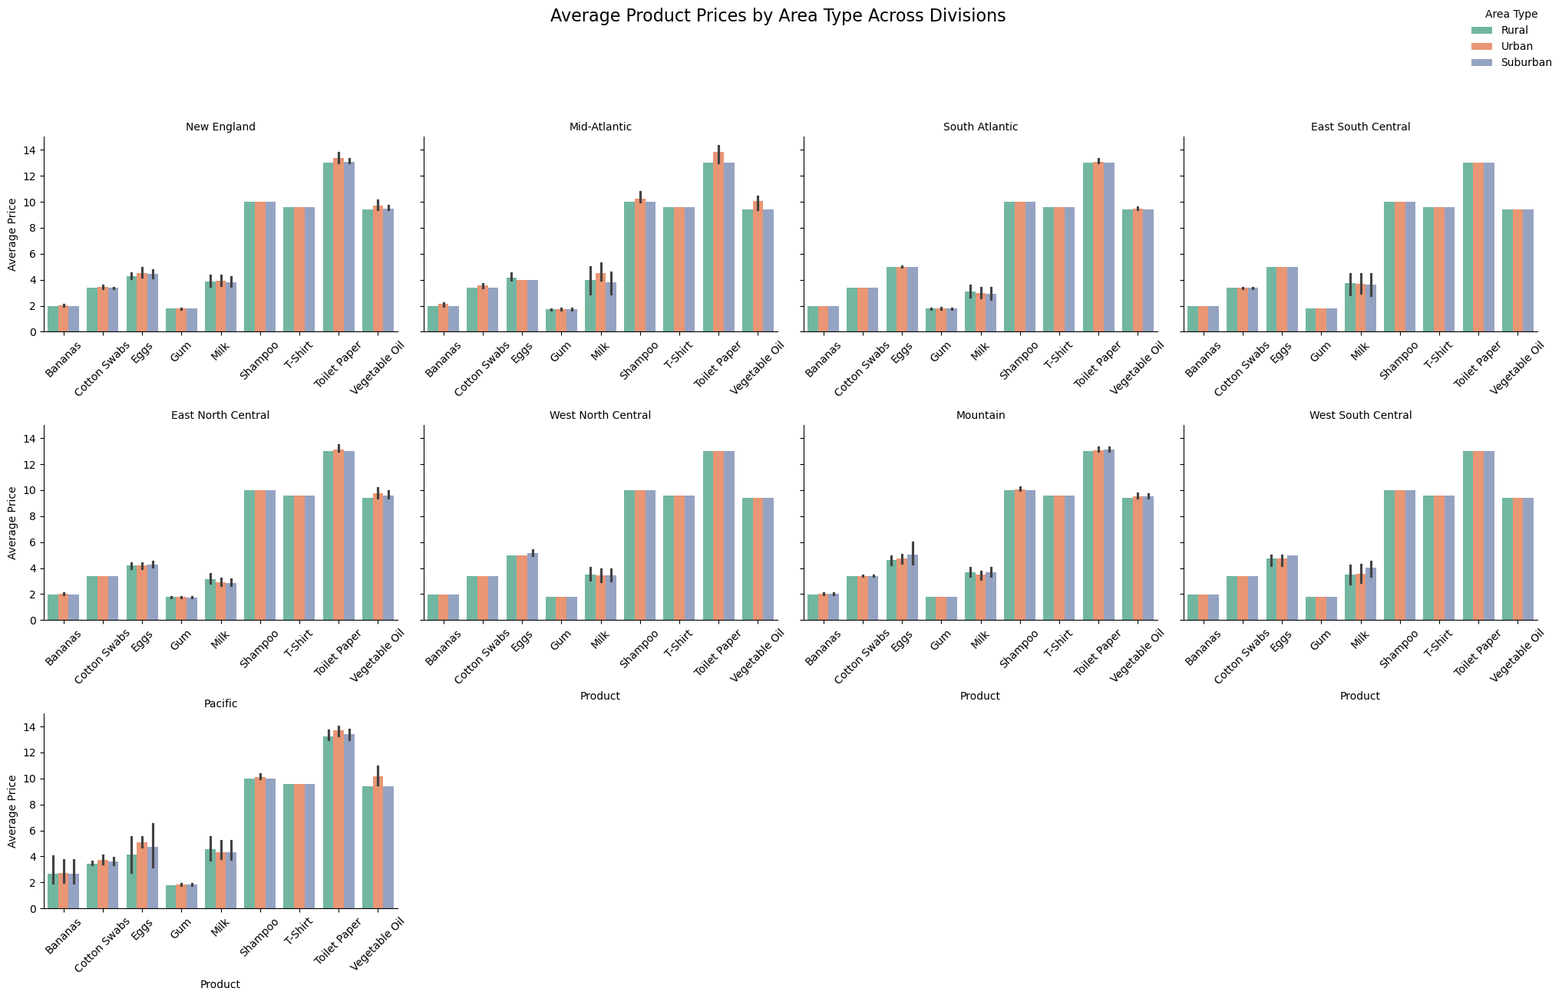
EDA

Slide 6
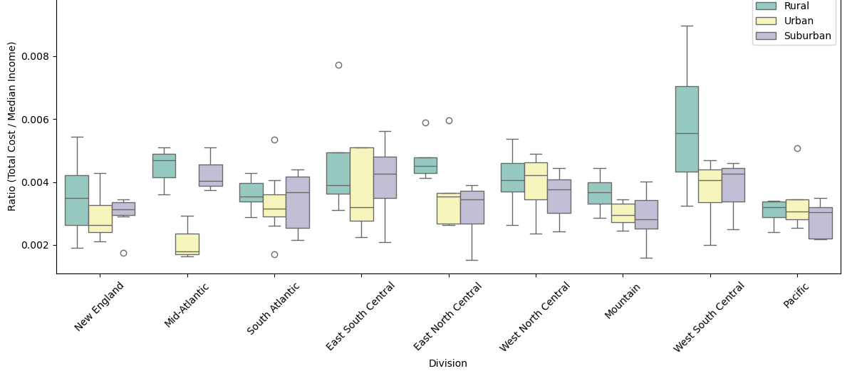
Total Basket Cost Divided By Median Income

Slide 7
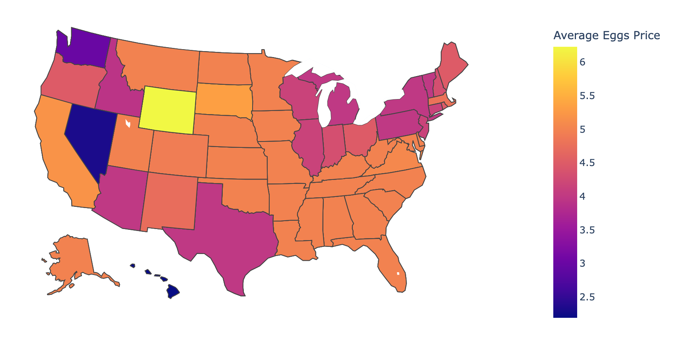
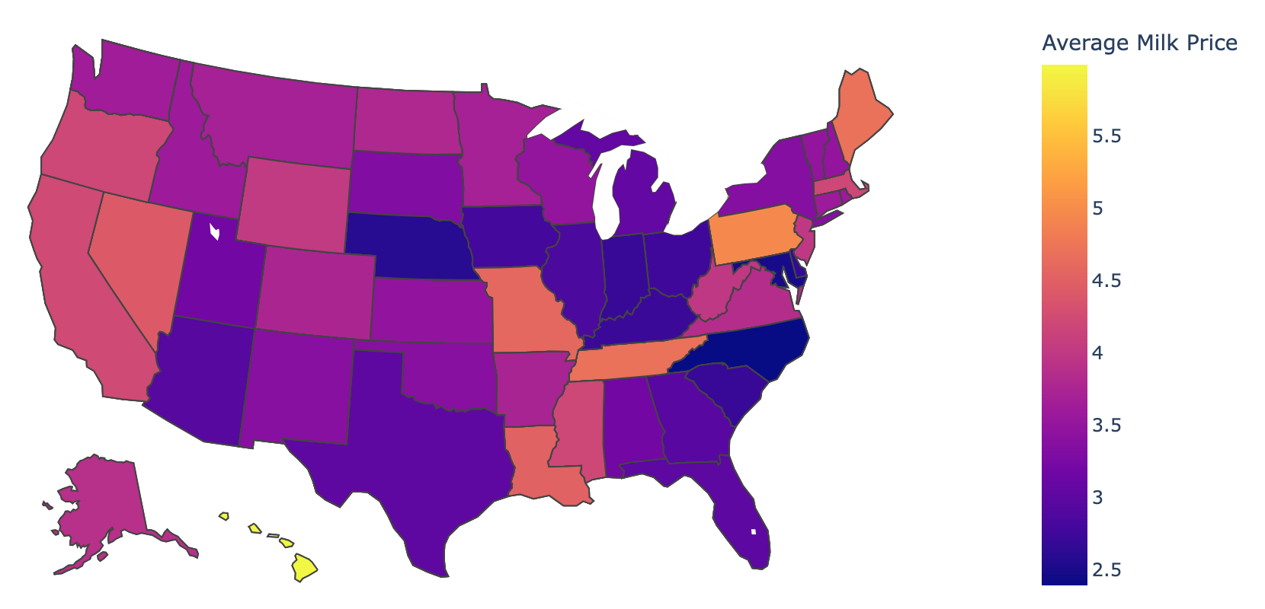
Average Prices

Slide 8
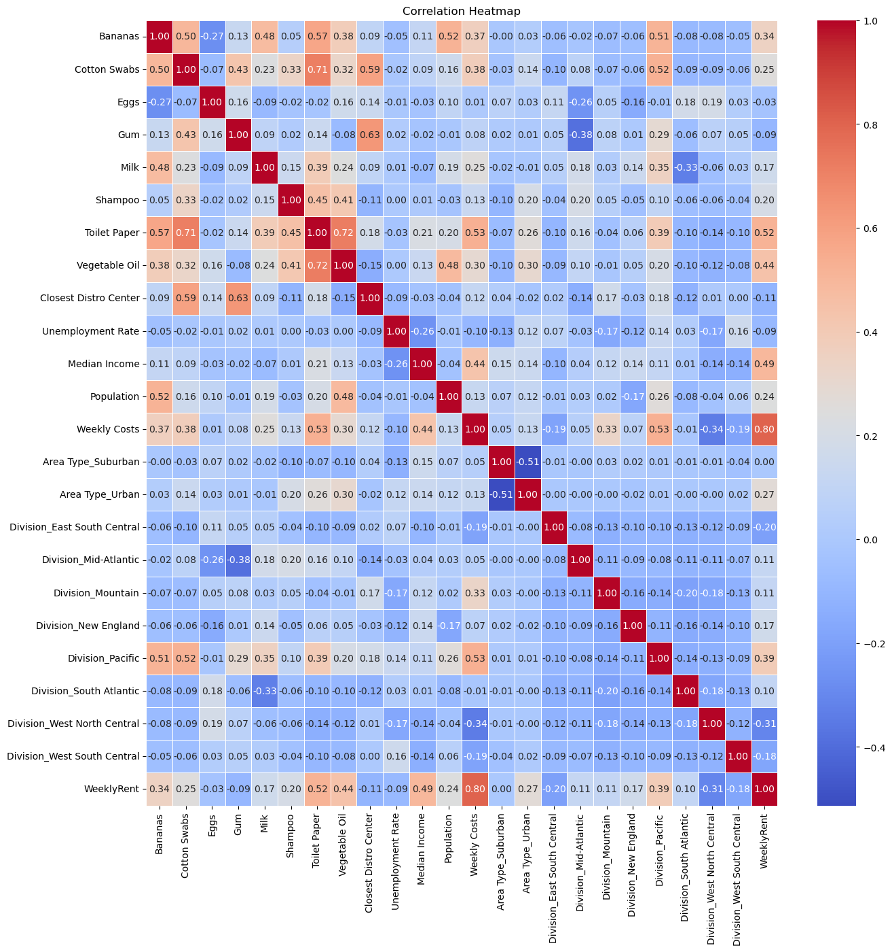
Heat Map

Slide 9
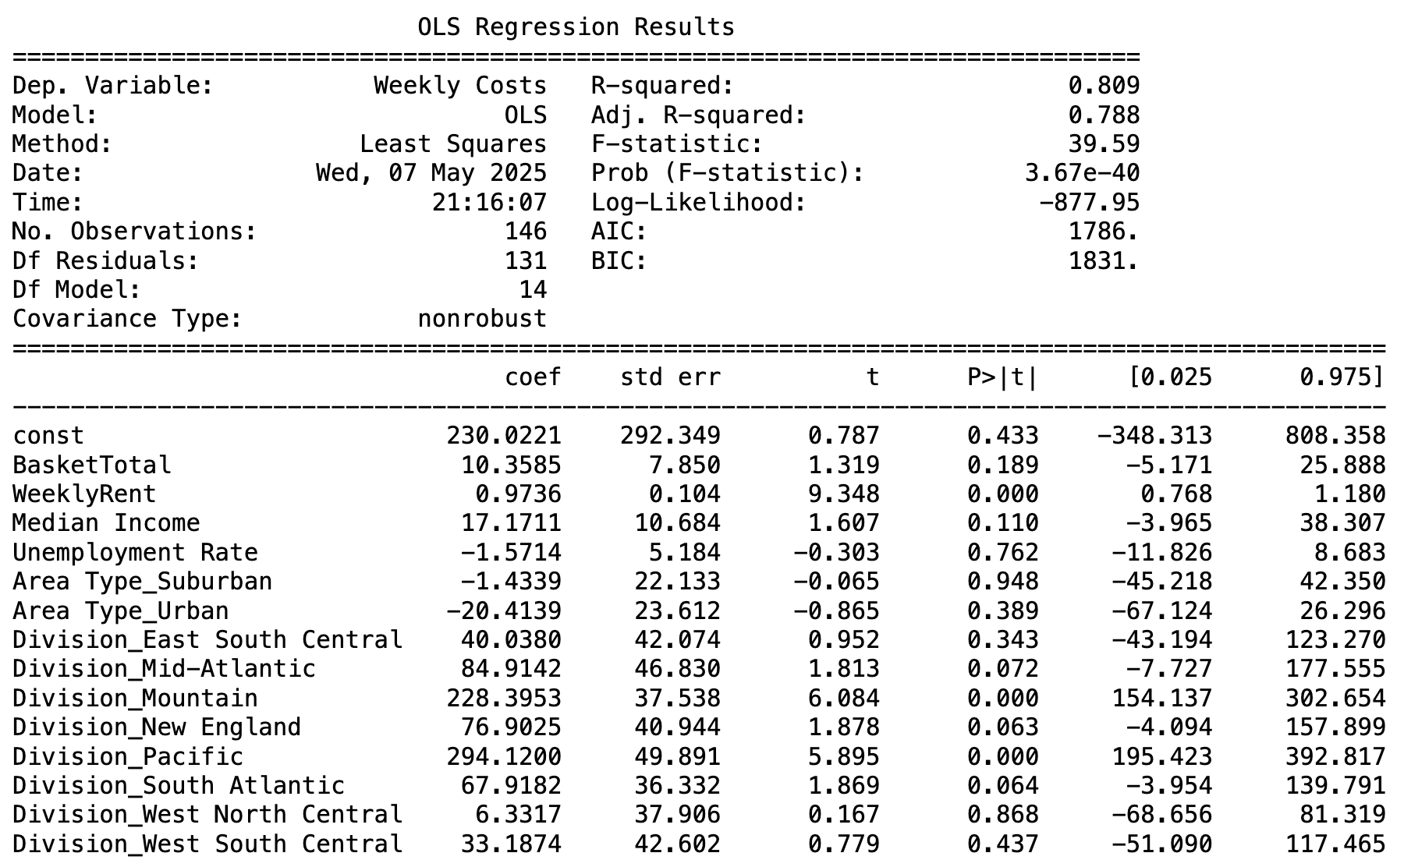
Linear Regression-Complete Weekly Costs

Slide 10
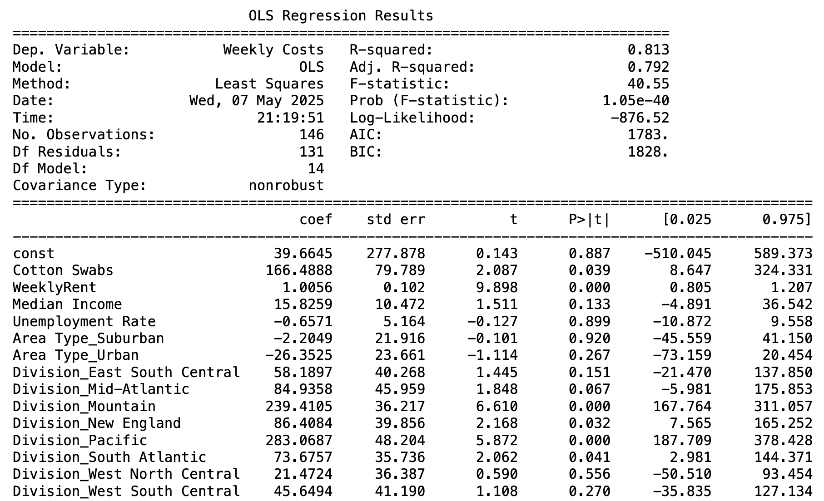
Linear Regression – Individual Products and Controls

Slide 11
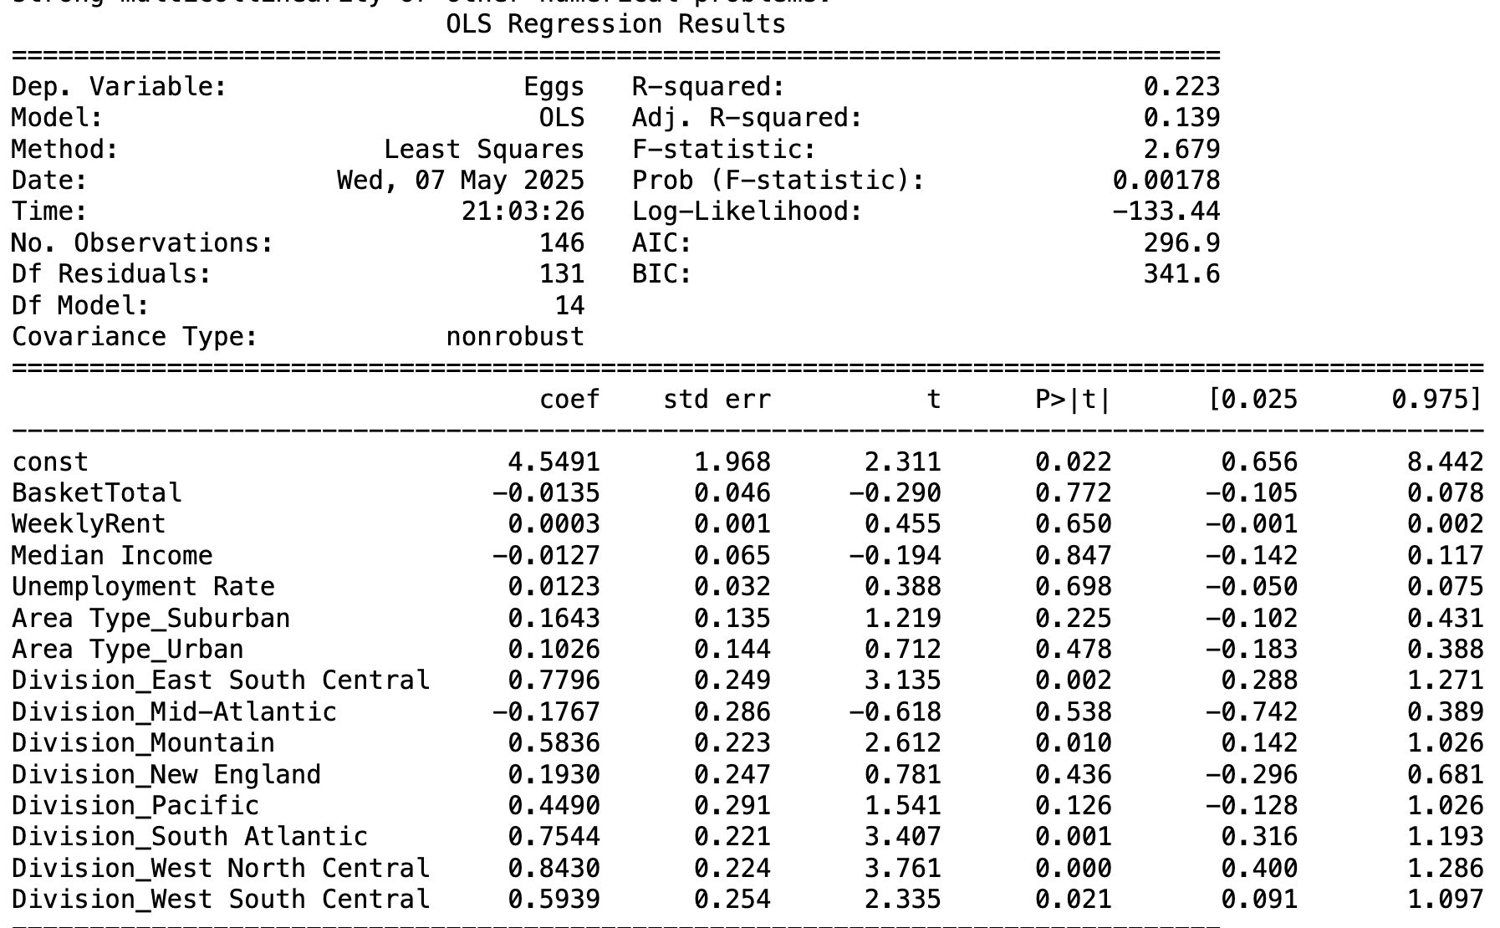


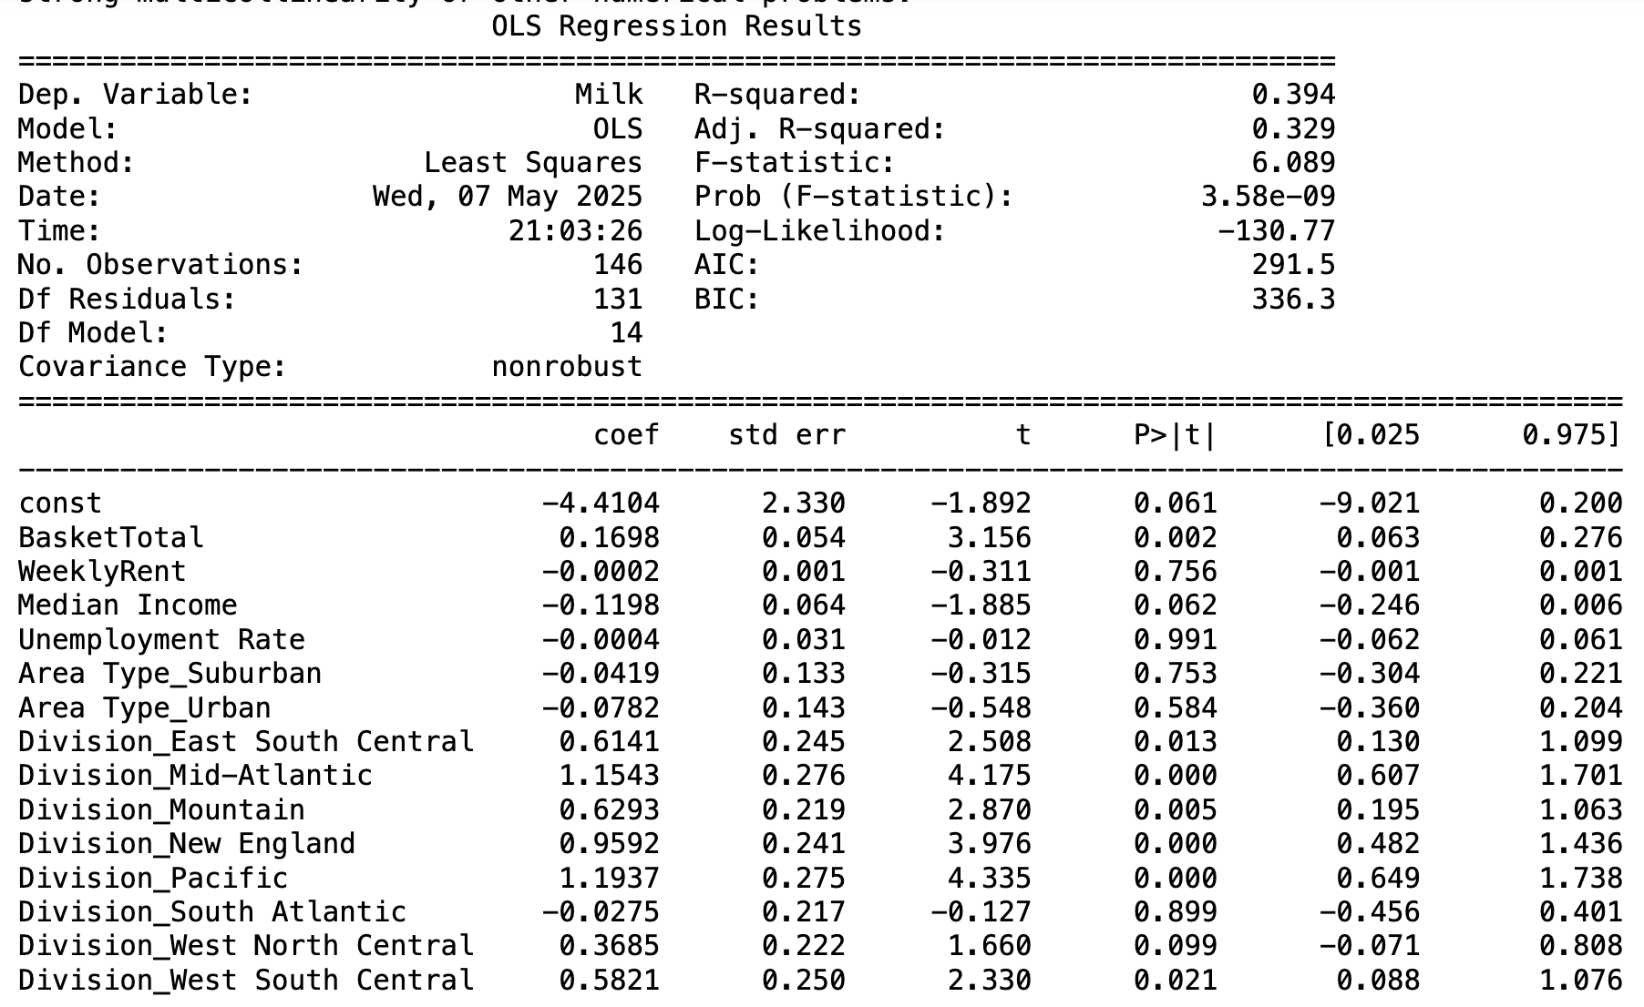
Linear Regression – Individual Products

Slide 12
Limitations/Further Research
Fixed point in time
-At this specific time, we collected Target data over a selected number of days
- Some items were also sold out or simply not offered at the store
-Current trends might not be applicable later
Sampling bias
-Rural, suburban, and urban locations for each state
- The products chosen might not accurately reflect category pricing
-Some states only had a few locations in mainly urban areas

Slide 13



Ethical, Legal, Social Implications
Social:
Individual: Gains knowledge and awareness
Community: Adds knowledge and advocation
Law: Gives policymakers insight to pricing differences between regions and area types
Ethical:
Despite supply chain issues to rural areas, rural customers have lower median incomes but are paying more for necessities
Legal:
Concerns of scraping for data privacy and in regulation with Target's policies

Slide 14
Stakeholder Implications
Consumers - Those who live close to two or more Targets can select which one to shop at based off of price differences
Target - Use local factors to determine price of goods
Competitors - Predict Target prices to undercut them
Small businesses – Can sell products at a lower price than Target and gain customers

